Slide 1
IVA 2023
CLIP: Contrastive Language Image Pre-Training
Notes:
‹#›

Slide 2
What is CLIP?
CLIP is a neural network trained on a variety of (image, text) pairs
It can be instructed in natural language to predict the most relevant text snippet, given an image (and vice versa), without directly optimizing for the task
CLIP is thus similar to the zero-shot capabilities of GPT-2 and 3
CLIP matches the performance of the original ResNet50 on ImageNet “zero-shot” without using any of the original 1.28M labeled examples

Slide 3
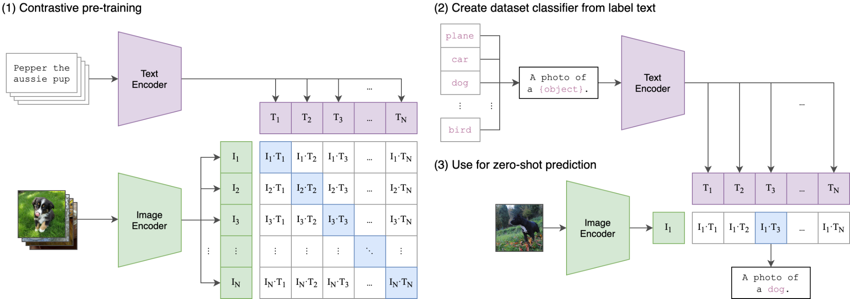
CLIP ARCHITECTURE
Contrastive pre-training is a type of self-supervised learning technique to learn representations of data that are useful for downstream tasks, such as image classification or natural language processing.

Slide 4
GLOSSARY
We will be using OPENAI's CLIP library (https://github.com/openai/CLIP)
The CLIP module clip provides the following methods:
clip.available_models()
Returns the names of the available CLIP models.
clip.load(name, device=..., jit=False)
Returns the model and the TorchVision transform needed by the model, specified by the model name returned by clip.available_models().
clip.tokenize(text: Union[str, List[str]], context_length=77)
Returns a LongTensor containing tokenized sequences of given text input(s). This can be used as the input to the model.

Slide 5
GLOSSARY
The model returned by clip.load() supports the following methods:
model.encode_image(image: Tensor)
Given a batch of images, returns the image features encoded by the vision portion of the CLIP model.
model.encode_text(text: Tensor)
Given a batch of text tokens, returns the text features encoded by the language portion of the CLIP model.
model(image: Tensor, text: Tensor)
Given a batch of images and a batch of text tokens, returns two Tensors, containing the logit scores corresponding to each image and text input. The values are cosine similarities between the corresponding image and text features, times 100.

